Slide 1
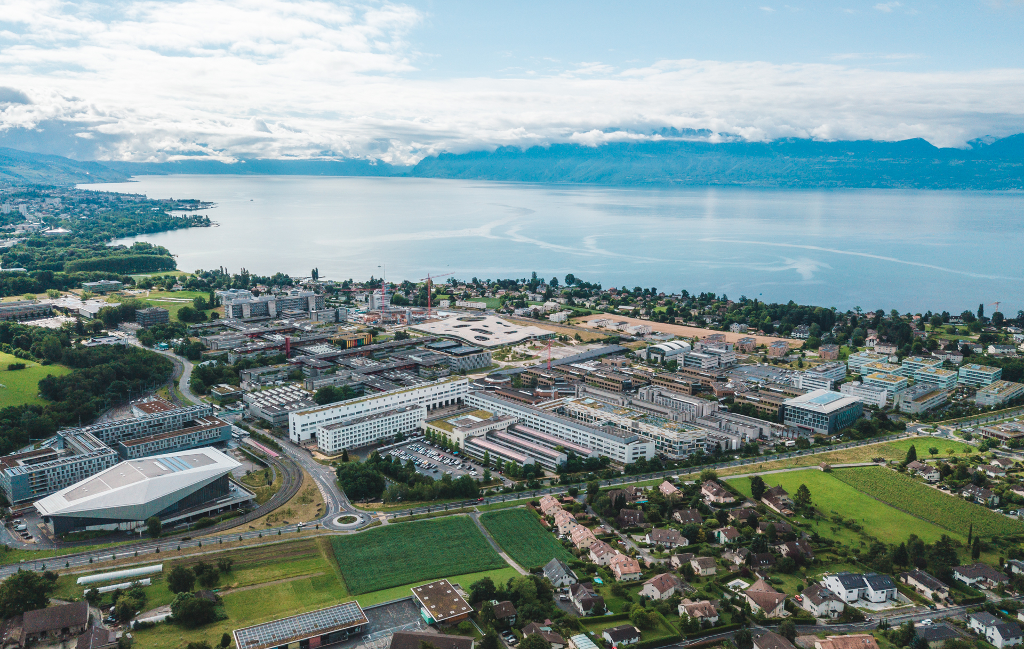
IAPR Final Project Spring 2023
Gianluca Radi
Alessandro Dalbesio
Camillo Nicolò De Sabbata
Group 5

Slide 2
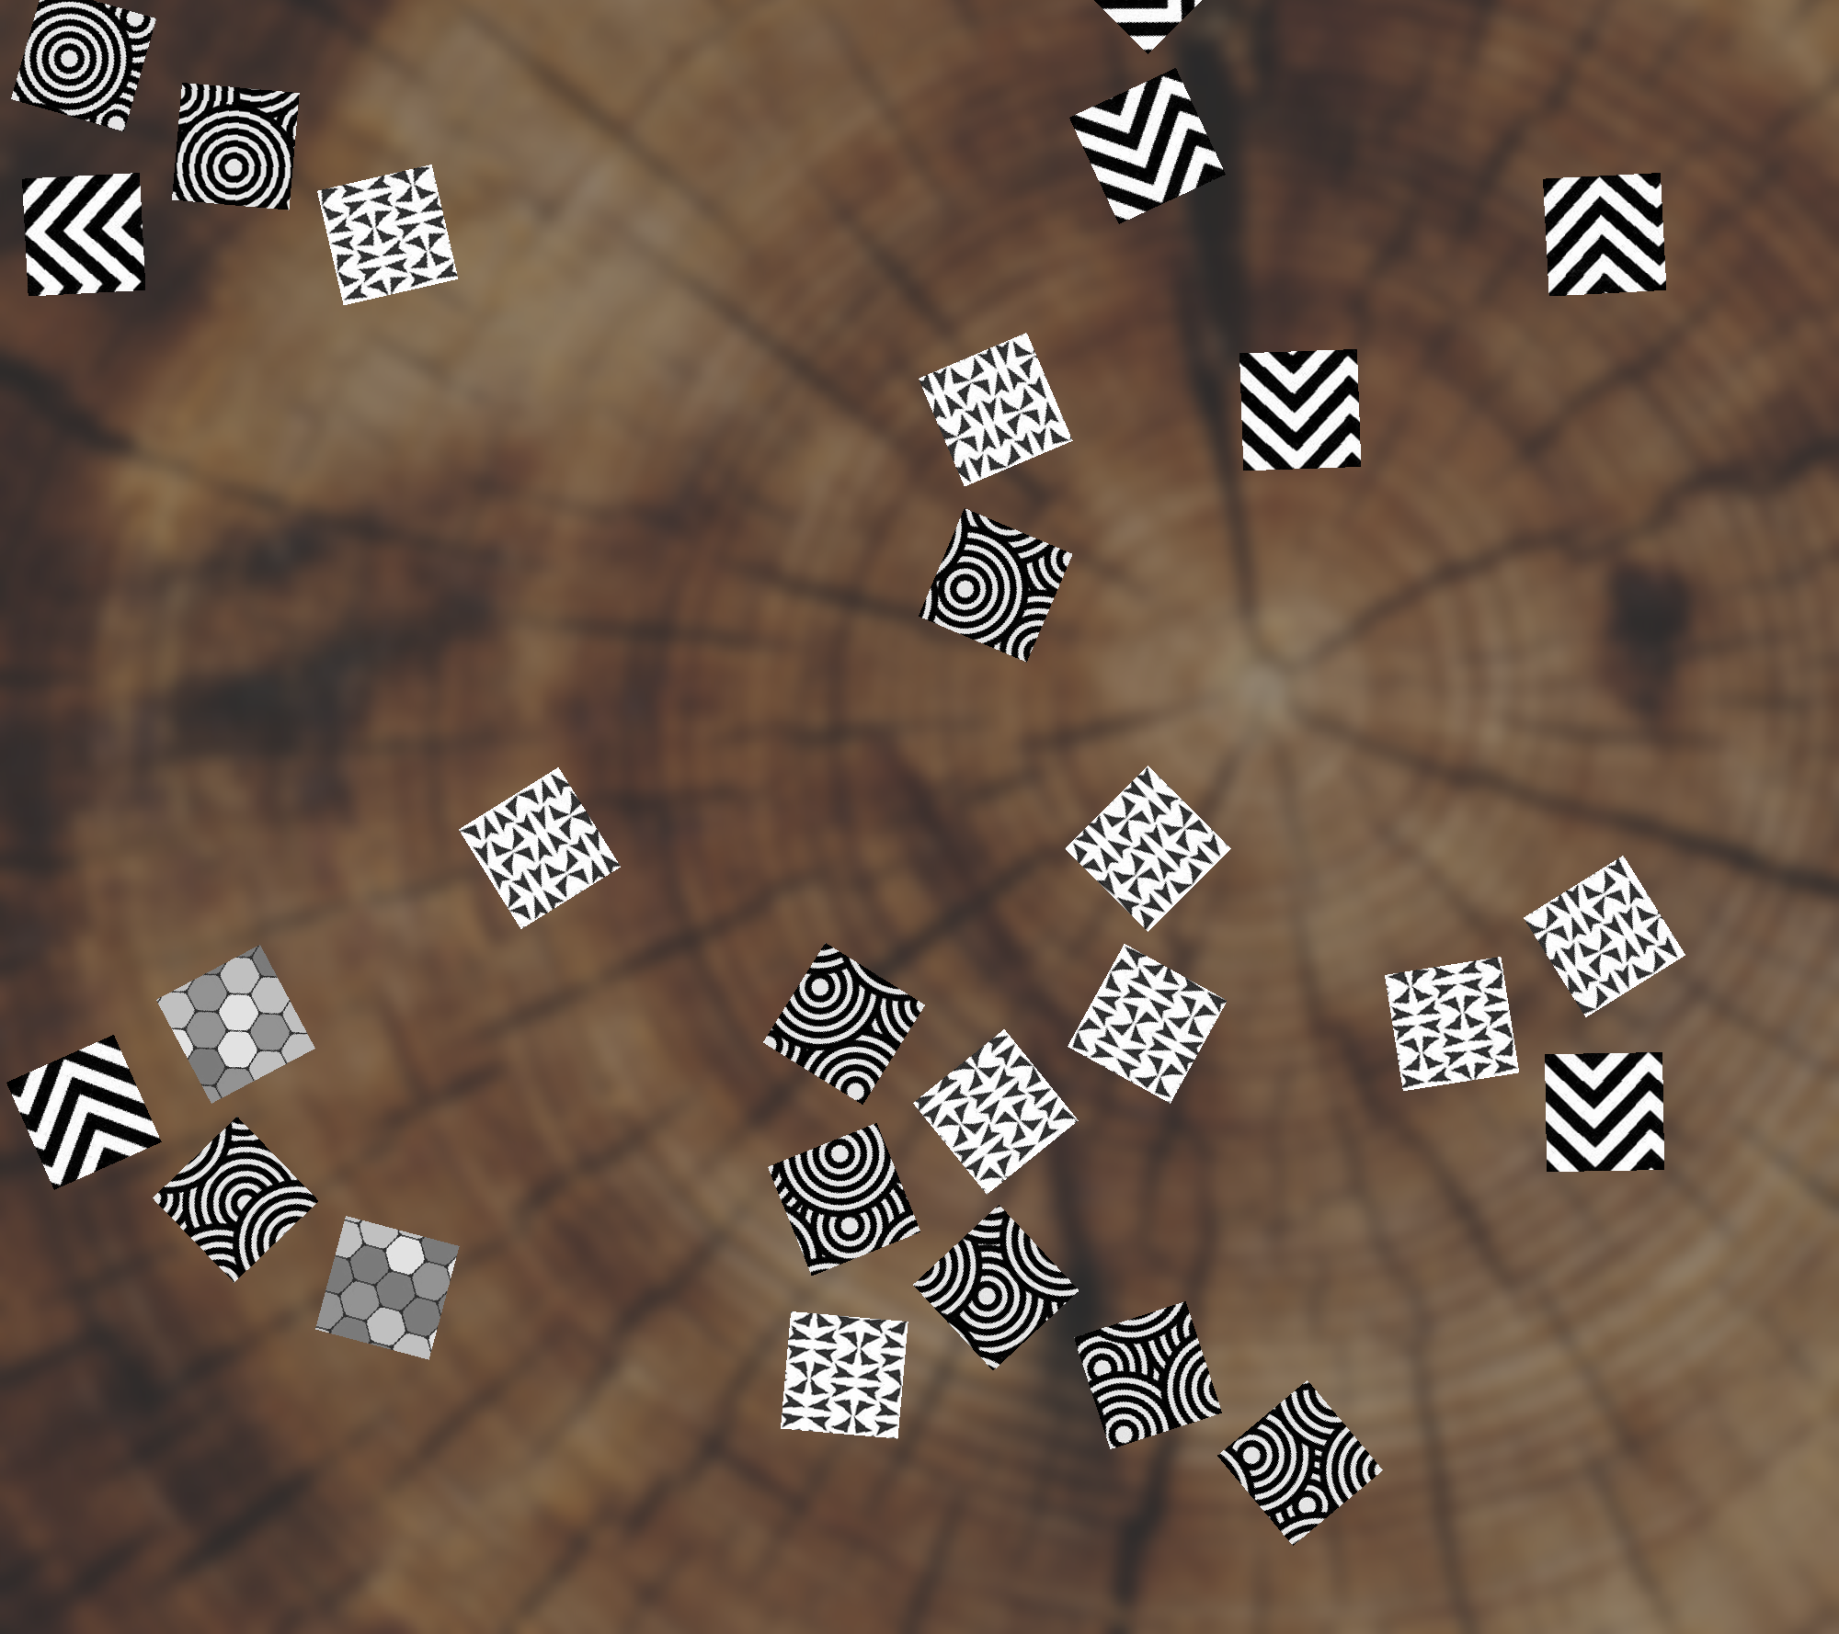
Introduction
Input: Several images of size 2000x2000 pixels each are provided.
Problem: The images contain jumbled pieces from two or more puzzles, requiring segmentation and clustering.
Goal: To organize the puzzle pieces into their respective groups.

Slide 3
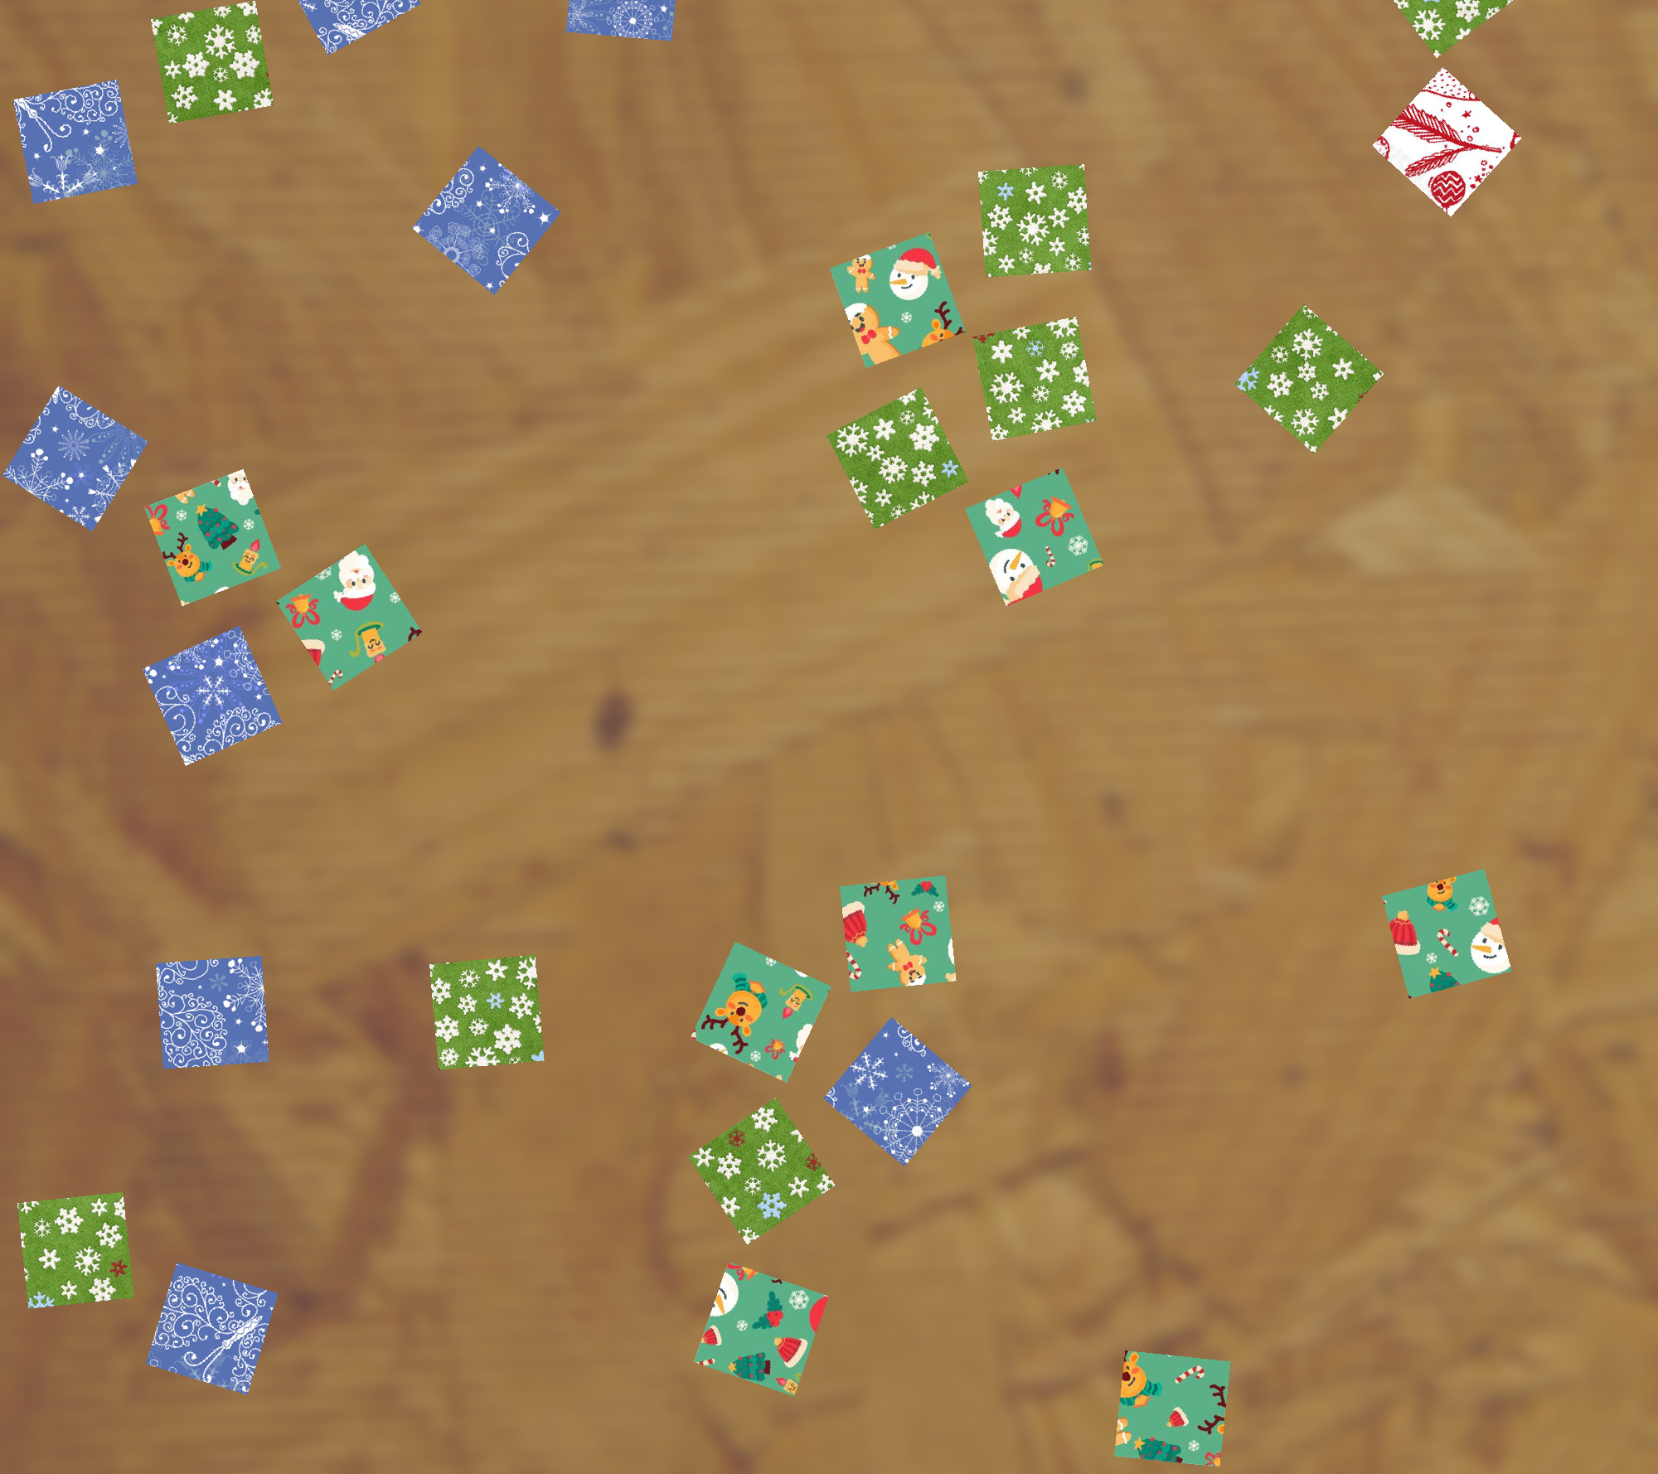
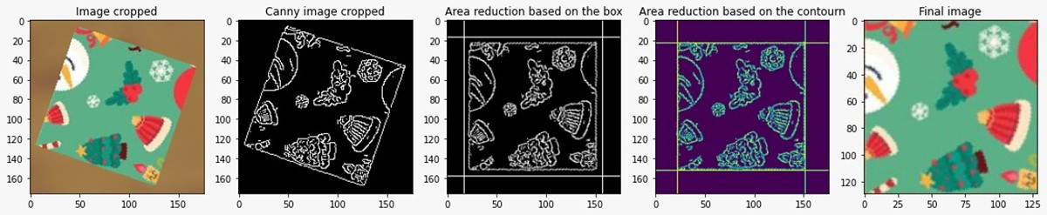
Introduction
To reach our goal, we have implemented a three-step pipeline:
Segmentation
Feature extraction
Clustering
FEATURES EXTRACTION
&
CLUSTERING
INPUT
SEGMENTATION
PUZZLE 1

Slide 4
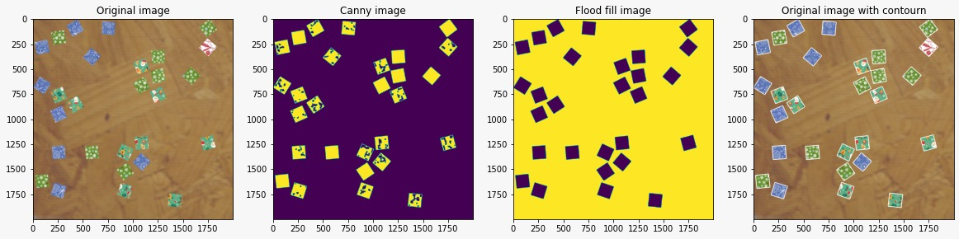
Segmentation
The segmentation is divided in two main phases:
Pieces labelling
Pieces extraction
Pieces Labelling
Pieces Extraction

Slide 5
Pieces Labelling
The pieces labelling is based on four steps:
Edge detection with Canny filter
Post processing of the obtained image with morphological operations
Flood fill to separate the objects from the background
Object labeling from the flood fill image and superimposition of the found contour on the original image

Slide 6
Pieces Extraction
The pieces extraction is based on four steps:
Cropping based on the contourn found in the pieces labelling step
Edge detection with Canny filter
Pieces rotation
Cleaning of obtained image (eliminate other pieces’ fragments)
Contour detection to identify where to crop the original rotated piece

Slide 7
Features Extraction
Feature extraction is performed in three steps:
The first step involves applying a mask obtained through canny edge detection to enhance the contours of the image.
A pre-trained convolutional neural network (CNN), specifically VGG16, is utilized to extract features from both the original image and the enhanced image.
Principal Component Analysis (PCA) is employed to extract the most significant features, those with the highest variance, from the set of extracted features. To address the issue of the ‘curse of dimensionality’, only 6 features are retained.

Slide 8
Clustering
Clustering is performed in three steps:
Firstly, we explore the potential combinations of puzzle sizes based on the number of extracted pieces.
For each discovered combination, a customized K-Means algorithm is utilized to create clusters consisting of pieces that are compatible in size. For example, if there are 23 pieces, the clusters would be formed as 12 + 9 + 2.
Finally, among the various clustering results obtained from the possible combinations, we select the one that minimizes the variance within the clusters (intra-cluster variance).

Slide 9
Clustering
Clustering is performed in three steps:
Firstly, we explore the potential combinations of puzzle sizes based on the number of extracted pieces.
For each discovered combination, a customized K-Means algorithm is utilized to create clusters consisting of pieces that are compatible in size. For example, if there are 23 pieces, the clusters would be formed as 12 + 9 + 2.
Finally, among the various clustering results obtained from the possible combinations, we select the one that minimizes the variance within the clusters (intra-cluster variance).

Slide 10
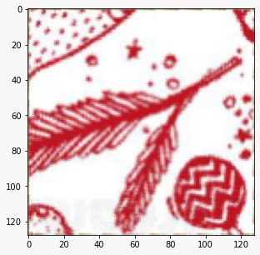
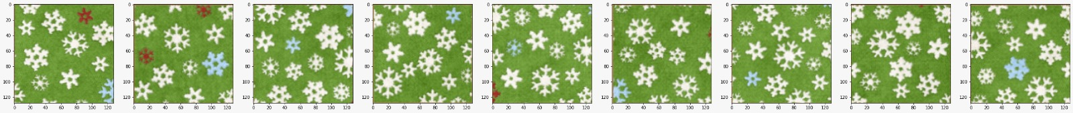
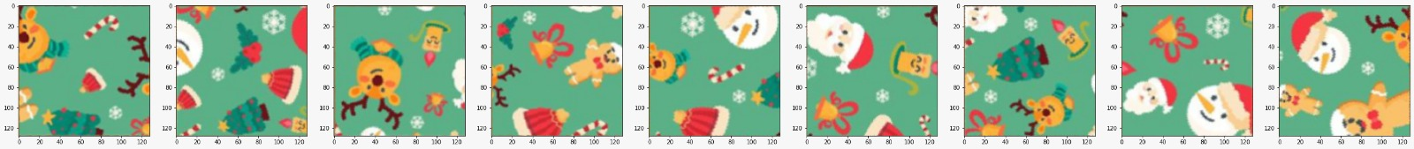
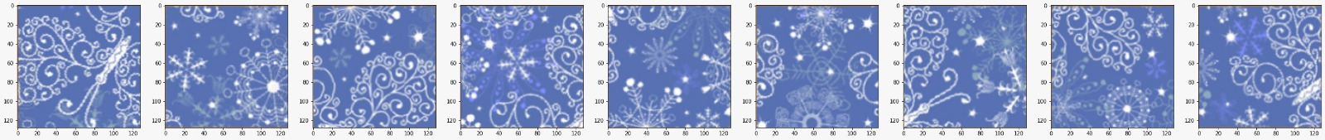
Clustering results

